Slide 1
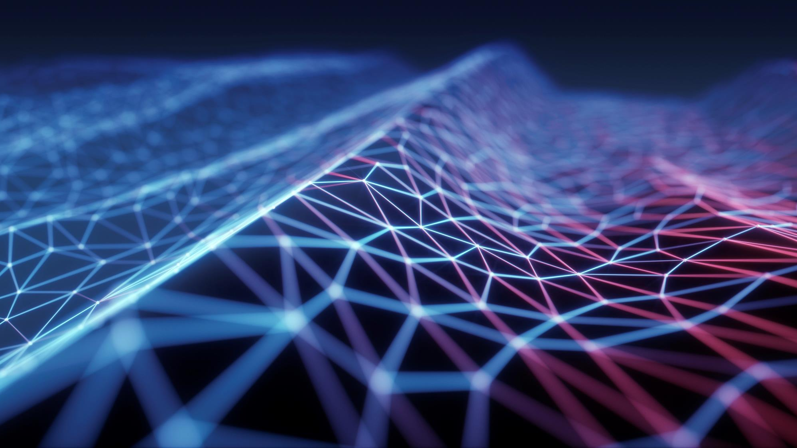

Interfacing of Molecular and Terahertz Communications for Internet of Nano Things (IoNT) Applications
BTP Code : B24LC01
Under Guidance of : Dr. Lokendra Chouhan

Slide 2

Agenda
Problem Statement & Research Goal
Nanomachines & Nanonetwork
Molecular Communication
What’s our Motivation to choose IONT
Terahertz Communication
Nano Communication
Reference

Slide 3
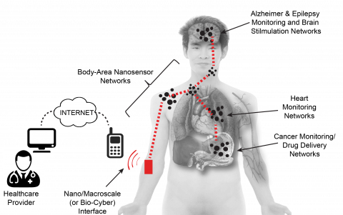
Problem Statement & research Goal
Objective
Investigating Molecular and Terahertz Communication Integration for IoNT
Research Goals:
Efficient Nanoscale Communication: Explore Molecular and Terahertz integration for IoNT.
Addressing IoNT Challenges: Overcome power, bandwidth, and reliability constraints.
Advancing IoNT Applications: Enhance healthcare monitoring, environmental sensing, and industrial automation.
Fig 1: Internet of Bio-Nano Things [1]

Slide 4
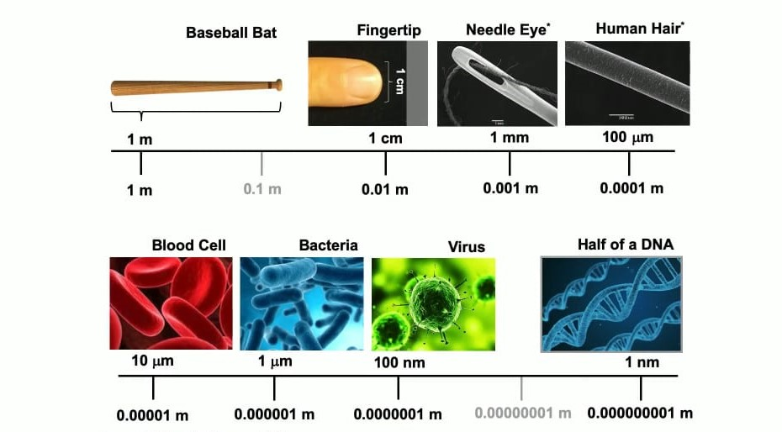
What is nano scale? “There's Plenty of Room at the Bottom -- Richard Feynman”
Fig 2: Nano scale spectrum [2]

Slide 5
Nano-communication
Nano-communication is the lifeblood of nano-networks, enabling seamless interactions between nano-devices and the broader micro or macro-systems they interface with.
Types of Nano-Communication
1. Molecular Communication : Utilizes chemical messengers for data exchange.
2. Electromagnetic Communication: Relies on electromagnetic waves for swift transmission.
3. Acoustic Communication: Harnesses sound waves for efficient data transfer.
4. Nano-Mechanical Communication: Utilizes mechanical means for precise information exchange.
These distinct modes of nano-communication, meticulously explored in prior research endeavors, lay the groundwork for fostering resilient and dynamic nano-networks.

Slide 6
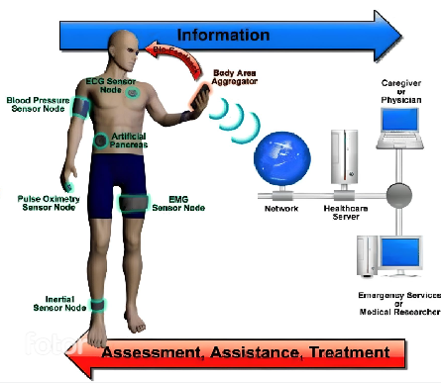
What’s our Motivation to choose IoNT:
Fig 3: Health Monitoring via Nano Sensors comprising Real Time Health Monitoring Internet of Nano Things (IoNT) [3]

Slide 7
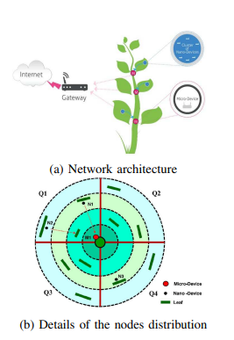
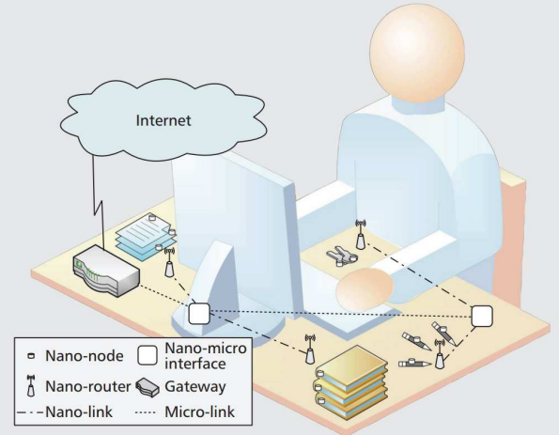
Application of Nanotechnology:
Fig 4: Network architecture of the Plant [4]
Fig 5: Network architecture of the e-office [4]

Slide 8
Nanomachines & Nanonetwork
Miniature devices engineered with sizes typically ranging from 1 to 100 nanometers.
Key Components:
Nano sensors, Nanoactuators, Nano Memory, Nano Antennas, Nano Processors, Nano EM Transceivers, Nano Power Units.
Precision and Functionality:
The design and integration of these components enable nanomachines to perform specific functions with extraordinary precision and functionality.
Challenges and Future:
Fabrication, control, environmental interactions.
Continued R&D crucial for realizing potential and addressing challenges.

Slide 9
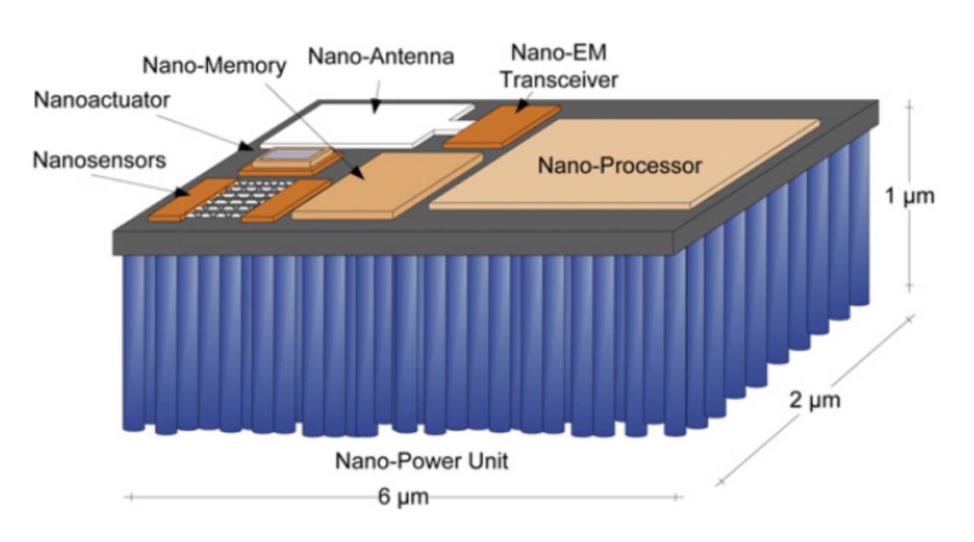
Nanomachine Architecture
Fig 6 :An integrated nano sensor device.[5]

Slide 10
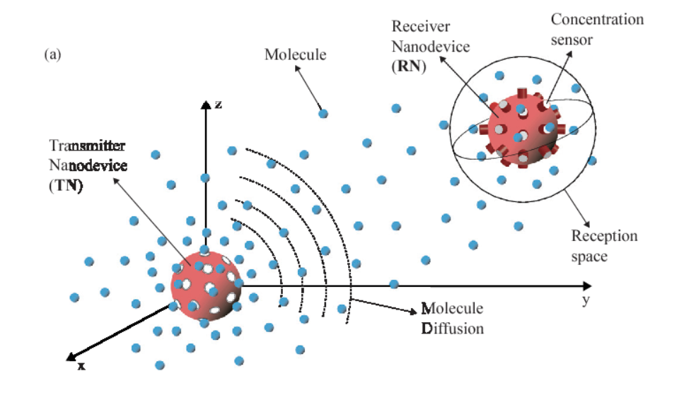
Molecular Communication
Molecular Communication is a method based on diffusion, inspired by biological systems, and useful over transmission distances in the nanometre to micrometre range.
Molecular Communication systems use the presence or absence of a selected type of Molecule to digitally encode messages. The molecules are delivered into communication media such as air and water for transmission.
Fig 7: The diffusion-based MC model between TN and RN.[6]

Slide 11
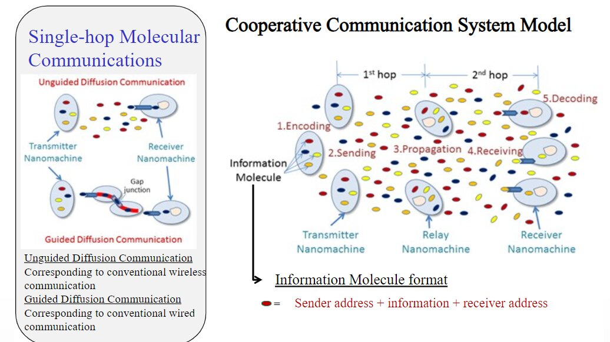
Molecular Communication
Fig 8: cooperative communication system model for molecular communications

Slide 12
Molecular Communication Advantages :
Molecular communication offers several advantages for nanoscale communication, including:
Biocompatibility: Utilizes naturally occurring molecules, making it suitable for communication within biological systems.
Low energy consumption: Molecular communication requires minimal energy compared to traditional electromagnetic methods, making it suitable for energy-constrained environments.
Robustness: Molecular signals can penetrate obstacles and operate in complex environments with minimal interference.

Slide 13
Terahertz Communication
Characteristics:
Utilizes terahertz (THz) waves for wireless data transmission.
Frequency range: 0.1 to 10 terahertz, between microwave and infrared radiation.
High Bandwidth
Advantage: Enables gigabit-per-second data rates.
Significance: Essential for handling large data volumes in modern communication systems.
Short Wavelength
Advantage: Facilitates miniaturization of components.
Significance: Enables development of compact communication devices and nanoscale communication.
Non-Ionizing Radiation
Advantage: Safe for biological tissues.
Significance: Opens possibilities for medical applications without harmful effects on living organisms.

Slide 14
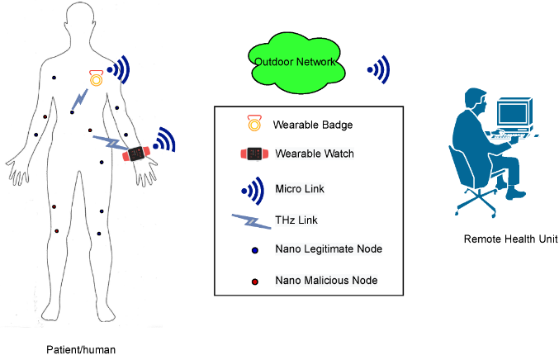
How Terahertz Communication helps to communicate Nano device ?
Fig 9: An envisioned future body-centric nanoscale healthcare system with possible malicious nodes.[7]

Slide 15
Terahertz Communication Applications
Terahertz communication has diverse applications across various fields, including:
Wireless communication: Terahertz waves can be used for high-speed wireless data transmission in environments where traditional radio frequency communication is limited.
Imaging and sensing: Terahertz imaging enables non-destructive inspection of materials, medical imaging, and security screening.
Medical diagnostics: Terahertz waves penetrate biological tissues with minimal absorption, enabling non-invasive imaging and sensing for medical diagnosis and monitoring.

Slide 16
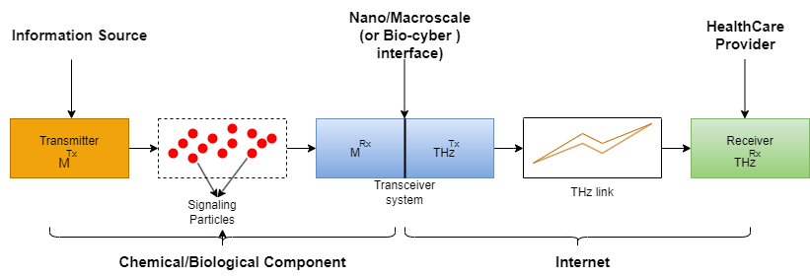
The sketch of the proposed nano communication network:
Fig 10: The sketch of the proposed nano communication network.[8]

Slide 17
Literature review
S No. | Research Paper | Summary
1. | A Comprehensive Survey on Hybrid Communication in Context of Molecular Communication and Terahertz Communication for Body-Centric Nanonetworks | The research paper explores the advancements in nanotechnology that have paved the way for the development of nanonetworks. It highlights the production of novel nano-materials and nano-particles with unique properties at the nanoscale. The collaborative effort in linking nano-devices has led to the vision of nanonetworks, expanding the capabilities of nano-machines. This shift towards nanonetworks from traditional IoT is driven by the potential of nano-communication paradigms like molecular and terahertz communication.
2. | Model-based: End-to-End Molecular Communication System through Deep Reinforcement Learning Auto Encoder | The research paper focuses on integrating Deep Reinforcement Learning (DRL) with Molecular Communication (MC) systems. A DRL autoencoder is utilized to optimize transceiver techniques for MC systems. The study demonstrates improved performance in terms of Bit-Error Rate (BER) optimization. The research paves the way for intelligent and efficient communication systems in nanoscale networks.

Slide 18
Literature review
S No. | Research Paper | Summary
1. | Modelling of the Terahertz Comm. Channel for In-vivo Nano-networks in the Presence of Noise | The research paper introduces a novel model for modelling communication channel noise in human tissues at the THz band. Results indicate that channel noise power spectral density decreases with distance and frequency, with higher noise levels in tissues with greater water concentration.
2. | Realizing Molecular Machine Learning Through Communications for Biological AI | The research paper explores the integration of Artificial Neural Networks (ANN) with gene regulatory networks (GRN) in biological systems for Molecular Machine Learning (MML). It discusses the use of intracellular molecular communication and engineered genetic circuits to enhance the efficiency and structure of ANN models in biological AI.
3. | Applications of molecular communications to medicine: a survey | The research paper explores the applications of molecular communications in medicine, highlighting the potential for personalized disease predictions and treatments. It emphasizes the use of nanotechnology to emulate biological processes, develop nano-sensors for disease detection, and optimize communication strategies for medical advancements.

Slide 19
Proposed Timeline
FEBRUARY
FEB
RUARY
AY
DECEMBER
1St Evaluation
2nd Evaluation
3rd Evaluation
4th Evaluation
Literature Review
Define scope and constraints
Defining problem statement
Understand the Basic of Molecular
and Terahertz
communications
Study channel modeling to analyze data flow rate.
Channel characteristics
Channel modelling methodology
Study channel modeling to analyze data flow rate.
Channel characteristics.
Channel modelling methodology.
Final Result.
Report writing.
Manuscript preparation and final submission
Literature Review
Define Scope and Constraints
Understand the Basic of Molecular
and Terahertz
communication
Study channel modeling to analyze data flow rate.
Channel Characteristics
Channel Modelling Methodology
Calculate the optimal Bit Error rate of Over all Channel.
Data collection from Mathematical equation.
Final Result.
Report writing.

Slide 20
REFERENCES
[1] https://ioe.eng.cam.ac.uk/Research/Research-Areas
[2] https://youtu.be/M8d3pxVb4c4?si=UFMwSgfi4HDtVMqX
[3]https://www.researchgate.net/publication/313523261_Internet_of_Nano_Things_IoNT_Next_Evolutionary_Step_in_Nanotechnology
[4] K. Yang et al., "A Comprehensive Survey on Hybrid Communication in Context of Molecular Communication and Terahertz Communication for Body-Centric Nanonetworks," in IEEE Transactions on Molecular, Biological and Multi-Scale Communications, vol. 6, no. 2, pp. 107-133, Nov. 2020, doi: 10.1109/TMBMC.2020.3017146.
keywords: {Nanobioscience;Monitoring;Biomedical monitoring;Nanoscale devices;Biomedical imaging;Molecular communication (telecommunication);Nano-communication;nano-technology;terahertz;molecular communication;hybrid networks},
[5] https://www.sciencedirect.com/science/article/abs/pii/S1878778910000050?via%3Dihub
[6] D. Kilinc and O. B. Akan, "Receiver Design for Molecular Communication," in IEEE Journal on Selected Areas in Communications, vol. 31, no. 12, pp. 705-714, December 2013, doi: 10.1109/JSAC.2013.SUP2.1213003.
keywords: {Noise;Equalizers;Receivers;Nanoscale devices;Measurement;Detectors;Joints;Molecular communication;sequence detection;channel equalization;signal-dependent noise;intersymbol interference},
[7] https://www.mdpi.com/1424-8220/21/10/3534
[8] https://www.semanticscholar.org/paper/A-Comprehensive-Survey-on-Hybrid-Communication-in-Yang-Bi/ea5d2f054c97ad34504167ac7e866e332b6c8423

Slide 21
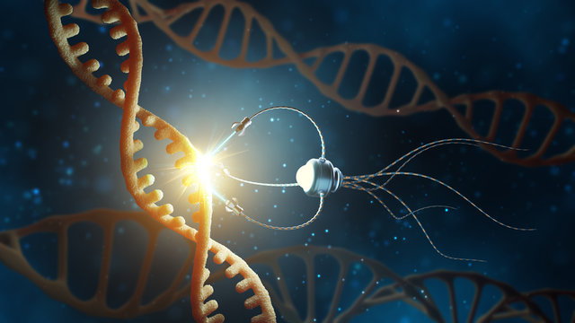
Thank You
Alkesh Shukla (S20210020252)
Anish Kamble (S20210020253)
BTP Guide : Dr. Lokendra Chouhan
BTP Code : B24LC01

